Slide 1

A SYSTEM TO PREDICT SOLAR RADIATION BY USING METEOROLOGICAL AND GEOGRAPHICAL INPUTS

Slide 2
Solar irradiance types
Direct Normal Irradiance (DNI)
Diffused Horizontal Irradiance (DHI)
Global Horizontal Irradiance (GHI)

Slide 3
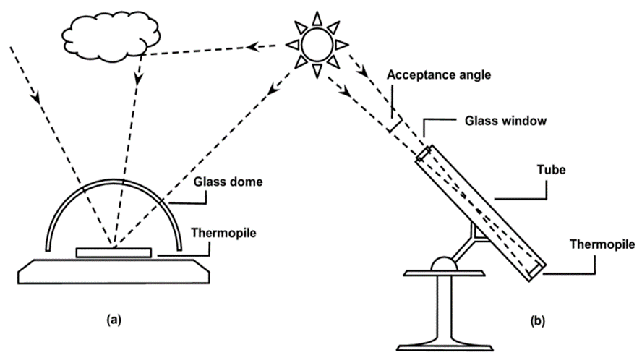
Sensor types of measure irradiance
Pyranometers measure Global Horizontal Irradiance.
Pyrheliometer measure Direct Normal Irradiance.
Pyranometers monitor radiation coming from all directions by looking up at the sky.
Pyrheliometers observe the sun directly and only measure radiation from one direction.
Notes:
Its like water. You can find, measure water easily but you cant breakdown helium and oxygen or measure their weight

Slide 4
Dataset
Numerical Values |  | Categorical Values
Features | Unit | Features | Meaning
DNI | w/m² | Cloud Type 0 | Clear
DHI | w/m² | Cloud Type 1 | Probably Clear
GHI | w/m² | Cloud Type 2 | Fog
Dew points | C(celsius) | Cloud Type 3 | Water
Temperature | C(celsius) | Cloud Type 4 | Super-Cooled Water
Pressure | mbar | Cloud Type 5 | Mixed
Relative Humidity | (percentage)% | Cloud Type 6 | Opaque Ice
Precipitable Water | cm | Cloud Type 7 | Cirrus
Wind Direction | Degree° | Cloud Type 8 | Overlapping
Wind Speed | m/s | Cloud Type 9 | Overshooting
Surface Albedo | ratio | Cloud Type 10 | Unknown
Clearsky DNI | w/m² | Cloud Type 11 | Dust
Clearsky GHI | w/m² | Cloud Type 12 | Smoke
Clearsky DHI | w/m² | Fill Flag 0 | N/A
Solar Zenith Angle | Degree° | Fill Flag 1 | Missing Image
 |  | Fill Flag 2 | Low irradiance
 |  | Fill Flag 3 | Exceeds Clearsky
 |  | Fill Flag 4 | Missing Cloud Properties
 |  | Fill Flag 5 | Rayleigh Violation
The dataset was received from the National Renewable Energy Laboratory of the US Department of Energy (NREL).
The dataset consists of hourly data at starting 00:30, 01.01.2017 to 23:30, 31.12.2017, Latitude: 41.09, Longitude : 29.1, Beykoz/ İstanbul/ Türkiye

Slide 5
Dataset
Numerical Values |  | Categorical Values
Features | Unit | Features | Meaning
DNI | w/m² | Cloud Type 0 | Clear
DHI | w/m² | Cloud Type 1 | Probably Clear
GHI | w/m² | Cloud Type 2 | Fog
Dew points | C(celsius) | Cloud Type 3 | Water
Temperature | C(celsius) | Cloud Type 4 | Super-Cooled Water
Pressure | mbar | Cloud Type 5 | Mixed
Relative Humidity | (percentage)% | Cloud Type 6 | Opaque Ice
Precipitable Water | cm | Cloud Type 7 | Cirrus
Wind Direction | Degree° | Cloud Type 8 | Overlapping
Wind Speed | m/s | Cloud Type 9 | Overshooting
Surface Albedo | ratio | Cloud Type 10 | Unknown
Clearsky DNI | w/m² | Cloud Type 11 | Dust
Clearsky GHI | w/m² | Cloud Type 12 | Smoke
Clearsky DHI | w/m² | Fill Flag 0 | N/A
Solar Zenith Angle | Degree° | Fill Flag 1 | Missing Image
 |  | Fill Flag 2 | Low irradiance
 |  | Fill Flag 3 | Exceeds Clearsky
 |  | Fill Flag 4 | Missing Cloud Properties
 |  | Fill Flag 5 | Rayleigh Violation
There are 8760 rows and 23 columns in the raw data set.
There are 2 value types are categorical and they are label-encoded. Others are numerical values, which doesn’t require label-encode.

Slide 6
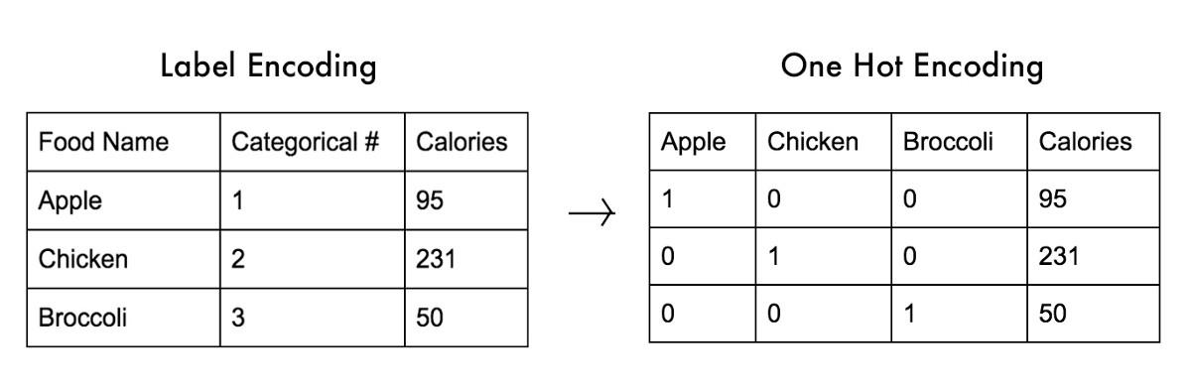
Label-encoding vs. one-hot-encoding
Cloudtype column represent as 1 column in dataset but since there are 13 different types of it; it cause hierarchy so onehot-encoding applied.

Slide 7
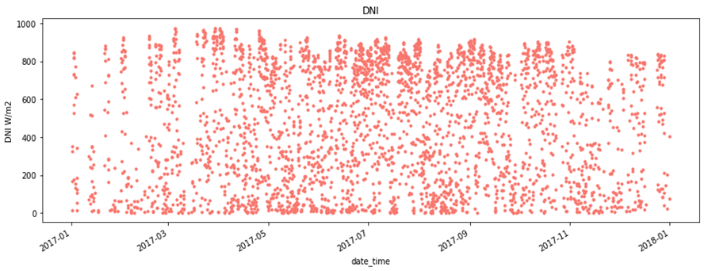
Pre-process
All rows having a DNI values of zero are eliminated since the purpose of this research is to predict DNI levels.
Date columns merged as %Y%M%D%h%m.
Also; Clearsky DNI , The Solar Zenith Angle and DHI columns are removed.
Thats because empiric method explained mathematical equation:
Global Horizontal Irradiance (GHI) = Direct Normal Irradiance (DNI)* cos(solar zenith angle) + Diffused Horizontal Irradiance (DHI)

Slide 8
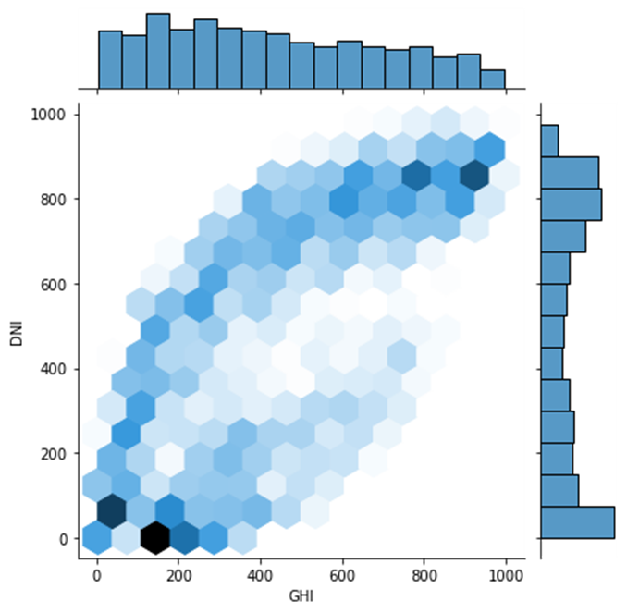
Pattern
Between GHI and DNI
W/m2
Global Horizontal Irradiance (GHI) = Direct Normal Irradiance (DNI)* cos(solar zenith angle) + Diffused Horizontal Irradiance (DHI)

Slide 9
Correlation
A linear relationship between variables is known as correlation.
It provides an overview of feature selection.
A strong linear relationship exists when a variable is close to 1 or -1.
Notes:
Its regression problem but, it doesnt mean linear regression always. It could be explanatory relation , logistic regression etc. For example if its explanatory, we can change columns log process then compare or inspect relationships.

Slide 10
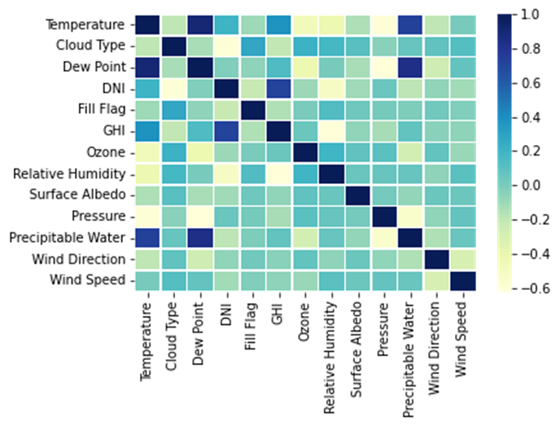
Correlation relationship between dataset’s columns

Slide 11

Dataset divided by 3 groups;
5% Validation data,
70% train and 30% test data of 95% dataset which is left
After 5% validation data removed.

Slide 12
Regression Model
Success Metrics
Root Mean square error(RMSE).
R-Squared (R2)
Mean Absolute Error(MAE)
Notes:
As a result, it indicates how dense the data is around the best-fitting line.

Slide 13
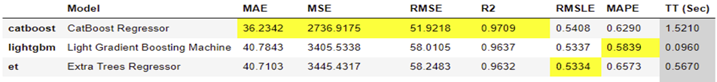
Modelling
CatBoostRegressor is most successful model
DNI W/m2 fluctuate between 1 and 976 and DNI mean value is :473 w/m2

Slide 14
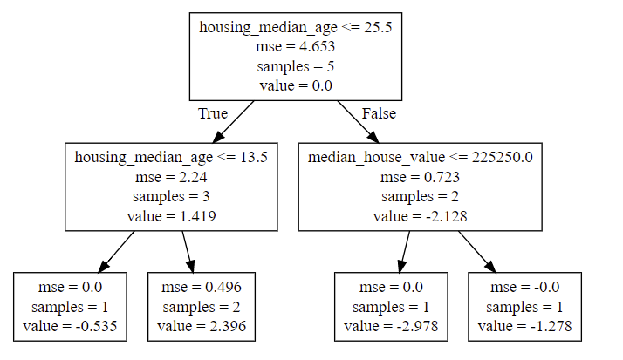
Decision tree example
Decision tree regression example on Boston house prices dataset

Slide 15
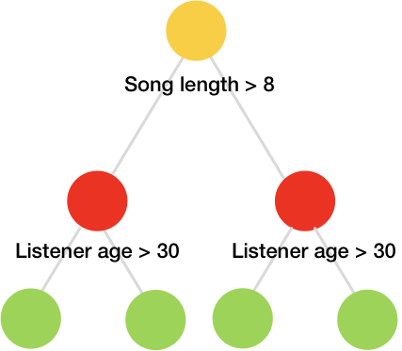
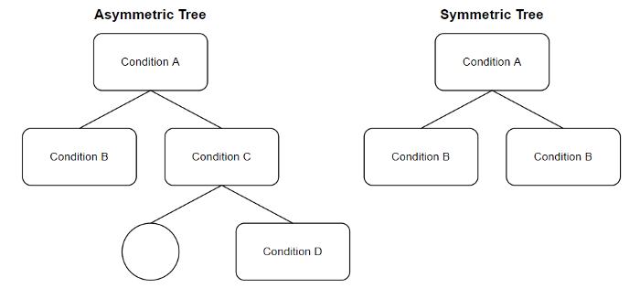
Catboost-regressor

Slide 16
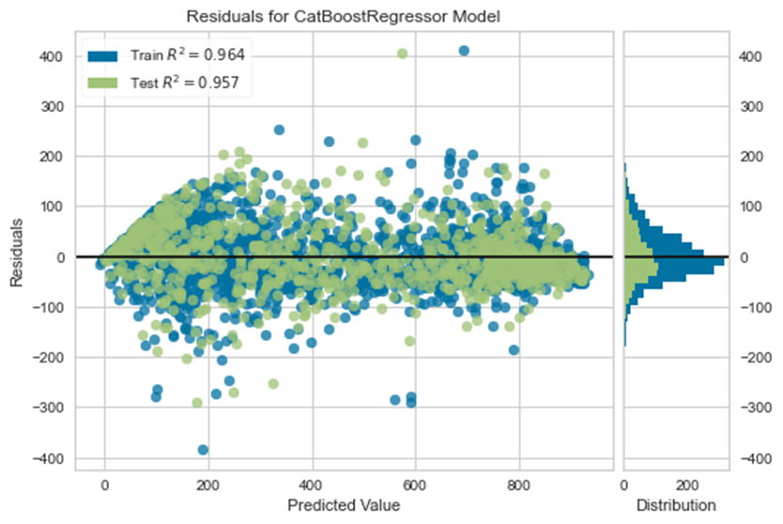
A residual plot
Vertical distance between a data point and regression line

Slide 17
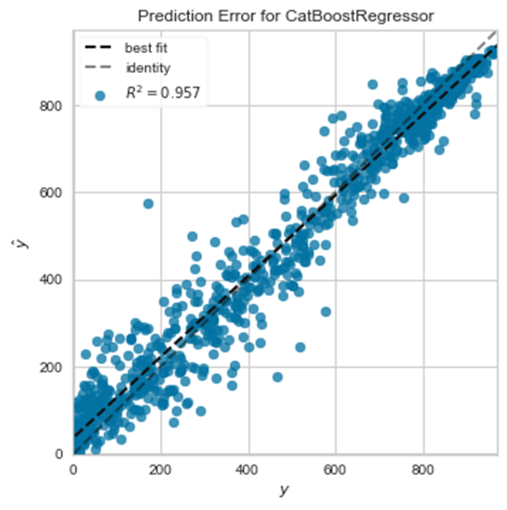
Prediction Error
Plot
Visual representation of the R2 coefficient

Slide 18
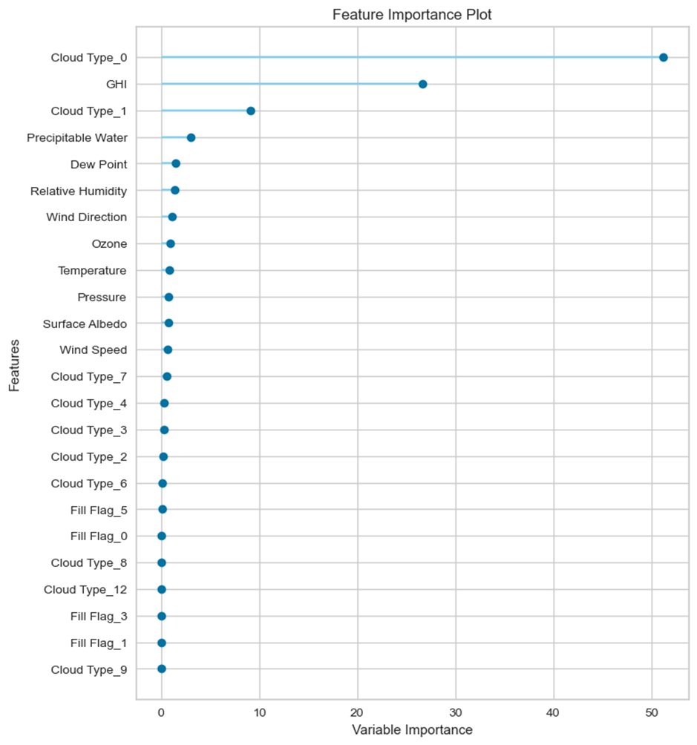
Feature importance
We removed some of features with 0 importance

Slide 19
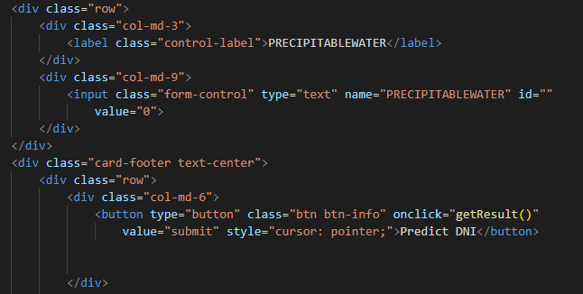
Get user input
This is form for collect what user enters.
Then click button execute function named getResult()

Slide 20
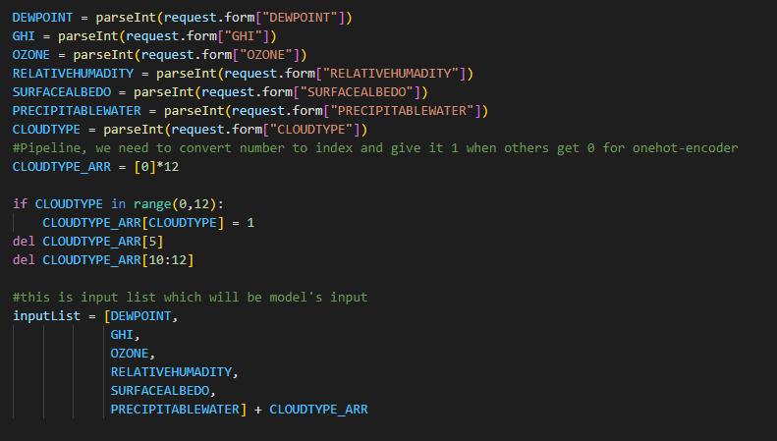
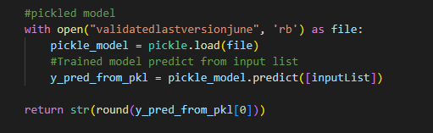
Variables created from forms,
that user entered values then inputlist created with these variables.
As you can see we just load pickled model, then used with .predict function.

Slide 21
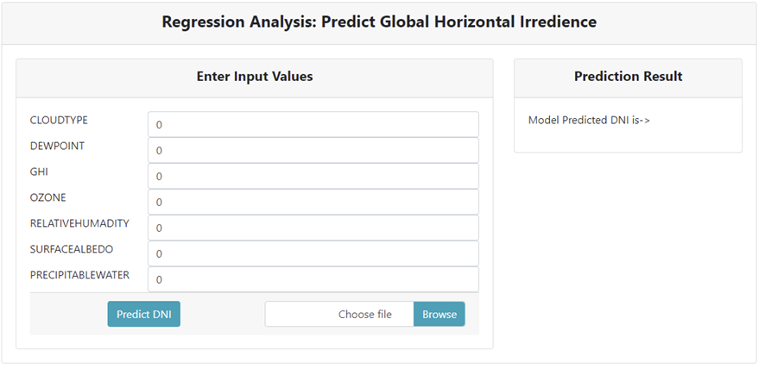
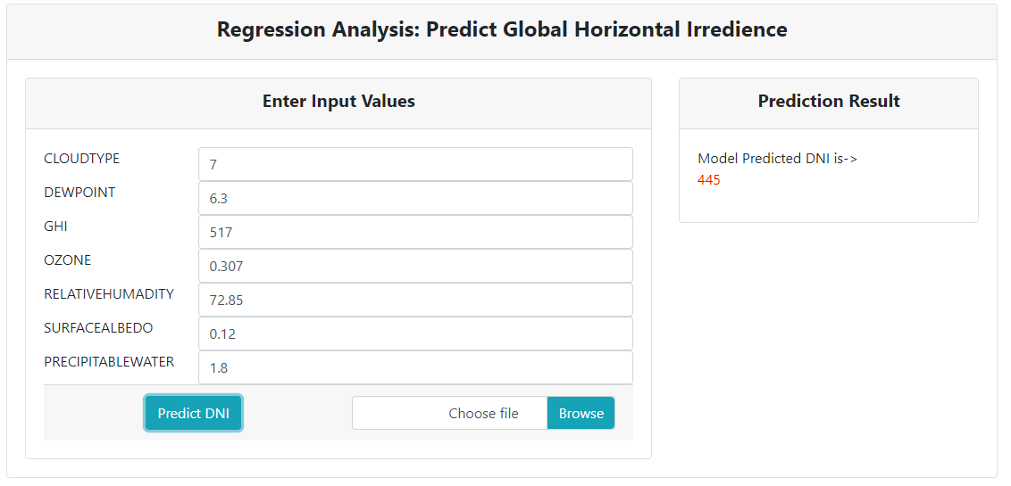
Interface of flask application

Slide 22
Conclusion

Slide 23
Thank you.

Slide 24
References
https://catboost.ai/news/catboost-enables-fast-gradient-boosting-on-decision-trees-using-gpus
https://machinelearningmastery.com/gentle-introduction-gradient-boosting-algorithm-machine-learning/

